Slide 1
Vehicle Detection USING A MAGNETIC SENSOR
by Lana Popova
Columbia, SC, USA

Slide 2

Objective
My goal is to design and implement a vehicle detection sensor for the purpose of automating the activation and deactivation of Halloween and Christmas lights near my house. This project’s scope, however, will be limited to the development of a sensor prototype that can detect vehicles passing on the designated lane where the sensor is installed, while disregarding vehicles on adjacent lanes.

Slide 3
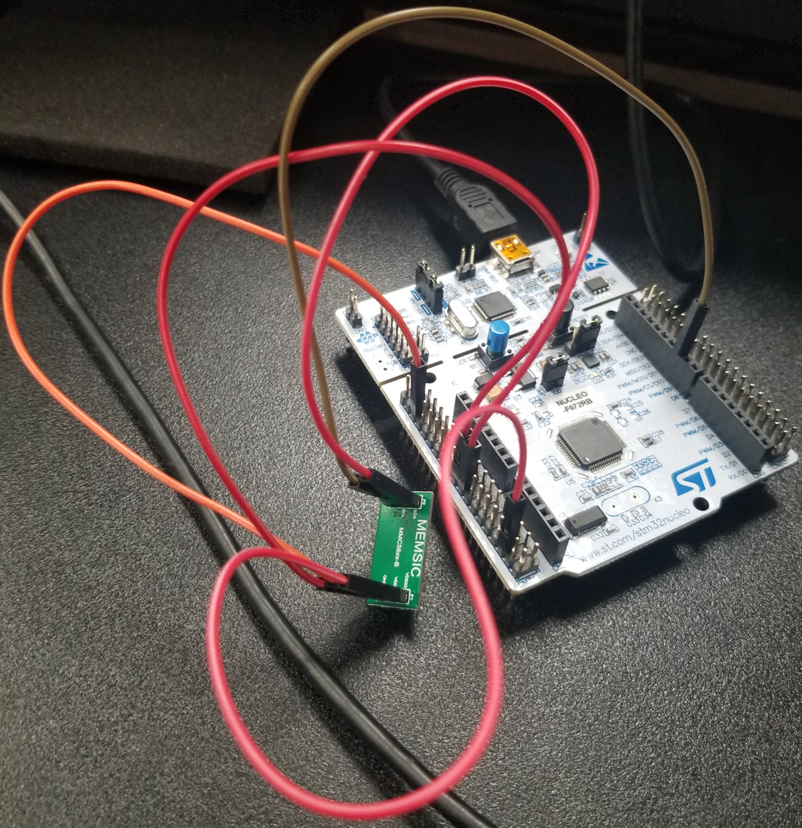
The Prototype
The prototype comprises the NUCLEO-F072RB and MMC5603NJ-B development boards. The latter integrates the MMC5603NJ sensor, a 3-axis Anisotropic Magneto-Resistive (AMR) sensor featuring an integrated signal processing circuit and a digital communication interface (I2C). With a measurement range of +/-30 Gauss (G), a 0.0625mG resolution, and a 2mG total RMS noise level, this sensor accurately measures magnetic field strength. Capable of detecting both the Earth's magnetic field and disruptions caused by passing vehicles, it plays a crucial role in the prototype's functionality.

Slide 4
The MMC5603NJ Driver
The "mmc5603nj" .c and .h files contain the implementation of the sensor's driver.
Internal functions:
Reading and writing of one or more registers to/from the sensor.
External functions:
Sensor initialization.
Magnetic field measurements.
The automatic set/reset functionality is activated to improve measurement accuracy.

Slide 5
Application Overview
The application designed for the NUCLEO board performs the following tasks:
Acquires magnetic field vector components from the sensor, using them to compute the magnitude of the magnetic field.
Identifies deviations in magnitude from a standard value, which allows inferring that there is a vehicle in close proximity to the sensor.
Communicates this information to the user through a serial terminal (UART) and an LED.

Slide 6
Application Code
The "main.c" file contains the application code, which is built upon the standard initialization and HAL code generated by the STM32 Cube MX software. The application uses a state machine, initializing the sensor, executing measurements, and detecting the presence of a nearby vehicle, as detailed in the "app" function. The I2C and UART interfaces, which facilitate communication with the sensor and application data transmission respectively, operate in a blocking mode. This simplified the application's architecture, maintaining an approximately 70 Hz sensor data rate — sufficient for detecting vehicles on the road near my house with a 35 MPH speed limit.

Slide 7
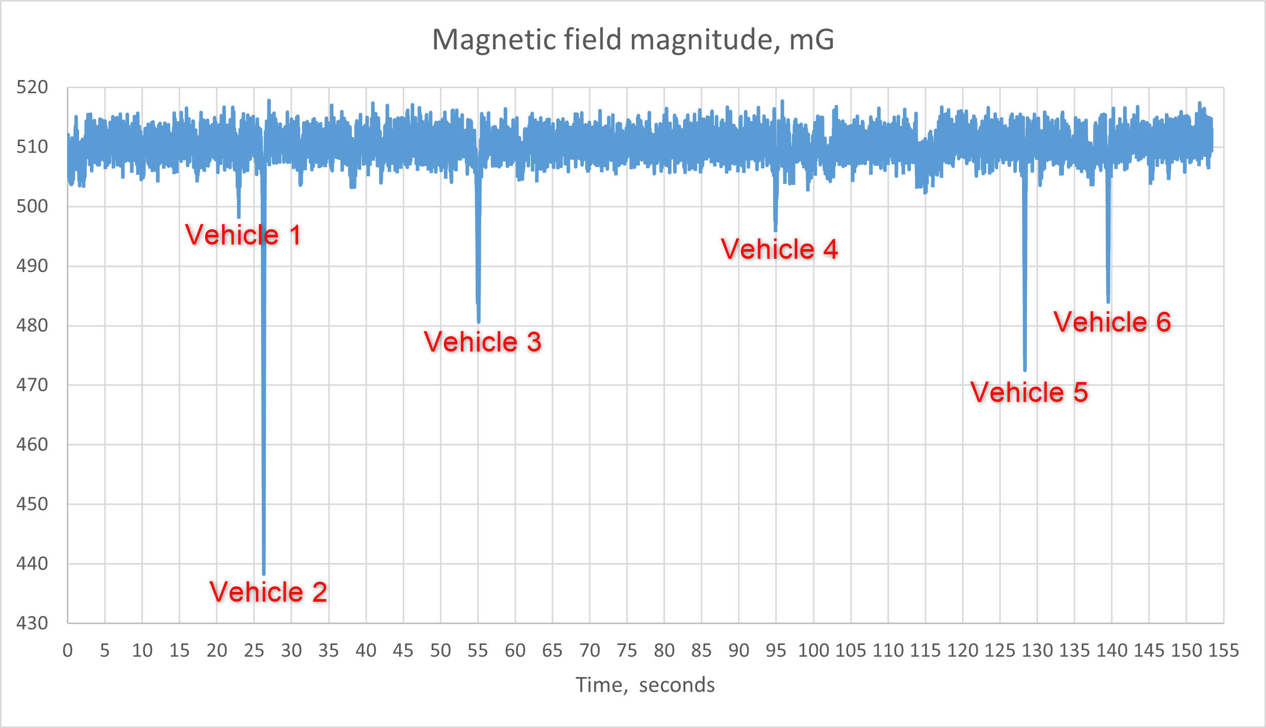
Detection Algorithm
Raw sensor data served as the basis for analyzing how passing vehicles affected sensor readings, refer to the figure on the right. This insight helped developing the detection algorithm, which involves deriving the magnetic field's average value and identifying deviations in data that surpass or fall below a predefined threshold. Refer to "detect_vehicle" function in "main.c“ for implementation details.

Slide 8
Moving Median
A moving median filter was applied to smooth data, establishing a baseline for comparison against the threshold.
To optimize computation, squared magnitude values were utilized for threshold comparison, eliminating the need for square root operations. This threshold was set at 12000 mG^2.
When the squared magnitude surpasses or falls below the average value, updates to the average value are paused until the squared magnitude has returned within the threshold.

Slide 9
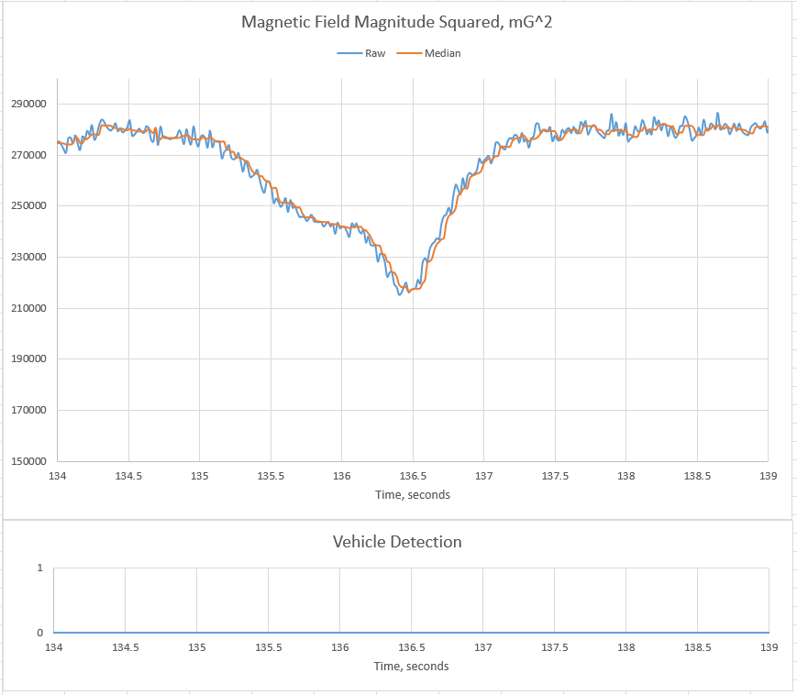
Missed Vehicles
Slower fluctuations in data lead to undetected vehicles. At around the 136-second mark in the figure on the right a vehicle wasn't detected by the algorithm. With a quicker rise time, the algorithm successfully detected the vehicle (the figure on the next slide, at around the 207-second mark).
Employing the decimation technique may offer a solution to ensure accurate vehicle detection

Slide 10
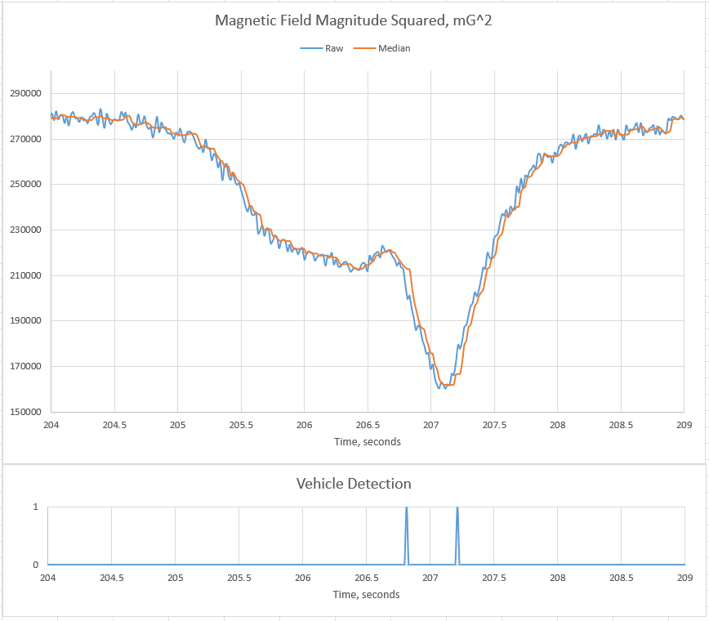
Duplicate Detection
The same vehicle can be detected twice due to the nature of sensor data as seen in the figure on the right at around the 207-second mark. This issue can be resolved by introducing a deactivation delay, which could be calculated considering the average speed of vehicles on the specific road section where the sensor will be deployed, as well as a reasonable minimum distance between two vehicles.

Slide 11




Thank you

